Slide 1
RailTopoModel a cornerstone to foster the federation of railway digital models
Alain Jeanmaire (SNCF réseau)
Airy Magnien (UIC)

Slide 2
Contents
RailTopoModel (RTM), some insights
The importance of being semantic
Putting flesh on the bones: comprehensive system representation
From model cooperation to model federation:
the S²R Common Data Model initiative

Slide 3
RailTopoModel
Some insights

Slide 4

What is RailTopoModel ?
RTM = RailTopoModel = Rail Topo Model = Railway topological model
An open, free, evolving UIC standard
Project Start : 2014
Delivered : IRS30100 (free download, no licensing fees)
Extensions in the works, esp. for BIM and asset management
Direct Participants:
ADIF, BLS, CFL, CIE, INFRABEL, MAV, ÖBB, PKP, SBB, SNCF, SZ, SZDC, ZSR
+ contributions from Academia and Research (RAILENIUM)
Notes:
RTM results from an initative taken in 2013 by several railway companies. The idea emerged in the context of the European Register of Infrastructure (RINF) works with the European Railway Agency.
The RINF topological model is essentially linked with the needs of the interoperability directive, and is of limited use for system planning or operations simulation.
The idea emerged to create, beyond a dedicated infrastructure model such as RINF, a universal metamodel called “RailTopoModel”. The metamodel should become suitable for any infrastructure information system, and enable the exchange of high quality, consistent, reliable data between information systems held by different stakeholders: for instance railway industrial suppliers, railway companies, or companies offering maintenance services.
In addition, many railway companies keep significant in-house expertise and manage their own maintenance services. Traditionally, each particlar activity (such as timetabling, track maintenance, signalling studies…) has its own reference network representation. Data exchange requires conversions and is time- and resource-consuming.
RailTopoModel is an attempt to make sure that different infrastructure information systems are built consistently and can exchange data with no distortion and no loss. RailTopoModel is not, in itself, a “data repository”, and does not intend to replace any of these.
IRS30100 has been delivered, that provides the “kernel” of RailTopoModel. Since the delivery in 2016, extensions are in the works.

Slide 5
What does RTM aim at ?
Allow to create, instantiate and maintain the “digital twin”
of the railway system … for all business domains
“Functional” Description
Asset Management
Operational aspect
Accurate digital description of the whole Network (including Routes, Track geometry,..)
At each step of its lifecycle
Including multiple levels of referencing (linear, geographic) and detail
Being able to take over “as built” drawings
Support asset management, maintenance planning
Using one consistent set of permanently updated information
Support network operation simulation
Hence, support simulation of power supply and signaling too
Of special interest: ETCS, Automatic Train Operation
Notes:
(largely self-speaking)

Slide 6
A glimpse into RTM topology & networks
Topology answers the question “what railway network element is connected to what other network element”,
regardless of connection type, scale or level of detail.
All Network elements (lines, or tracks, or stations…) are graph nodes
Elements can be expanded and detailed (macro ⬄ meso ⬄ micro)
As many topologies as relation types!
Macro network level (stations, lines…)
Micro network level (tracks)
Navigable = TRUE
Navigable = FALSE
Notes:
The “topology” used by RTM rests on a graph model developed in a PhD Thesis in 2008-2009. The fundamental idea is to represent the network as a graph where every element is a NODE (instead of the usual way : lines = edges, stations = nodes). Edges are now used to describe precisely the type of relations between nodes.
At macro level, the NODEs are (in our example) : Station A, Station B, and Line A-B. The EDGES are the four blue arrows, expressing that station A can serve line A-B and be served from line A-B, etc.
At micro level, we only see tracks (that may have been contained in lines or stations). The NODES are track section A, track section B, and track section C. The switch is not considered; it is only a device that helps getting from A to B, from B to A, from A to C, from C to A, but NOT from B to C, nor C to B. The switch function is fully expressed by the six relations depicted: 4 are possible (the blue ones), two are impossible without reversing, the orange ones.
As the switch function is fully expressed by relations (EDGES), the switch itself need not be considered as a node, in this « micro » view. The switch would then be a material device attached to the topology and having a location, but nothing more.
Other levels of representation are possible than the « micro » and « macro » views above, and the RTM user is free to introduce them. For instance, some users have introduced the nano view, where the relations in the macro view can be deducted from the switch blade positions in the nano view, but this nano view corresponds to a somewhat « exotic » use case. If you have other use cases, RTM will allow you to introduce corresponding views.
Such a way may look counter-intuitive, is however simple, and proved immensely helpful: it allows a consistent description of the railway network, no matter the “zooming” level.
Even better, the graph model does not make any assumption about the nature of the network or the type of relations. It can be generalized to other networks that are also relevant to the rail system, such as the power supply network, the telecom network, or the drainage...

Slide 7
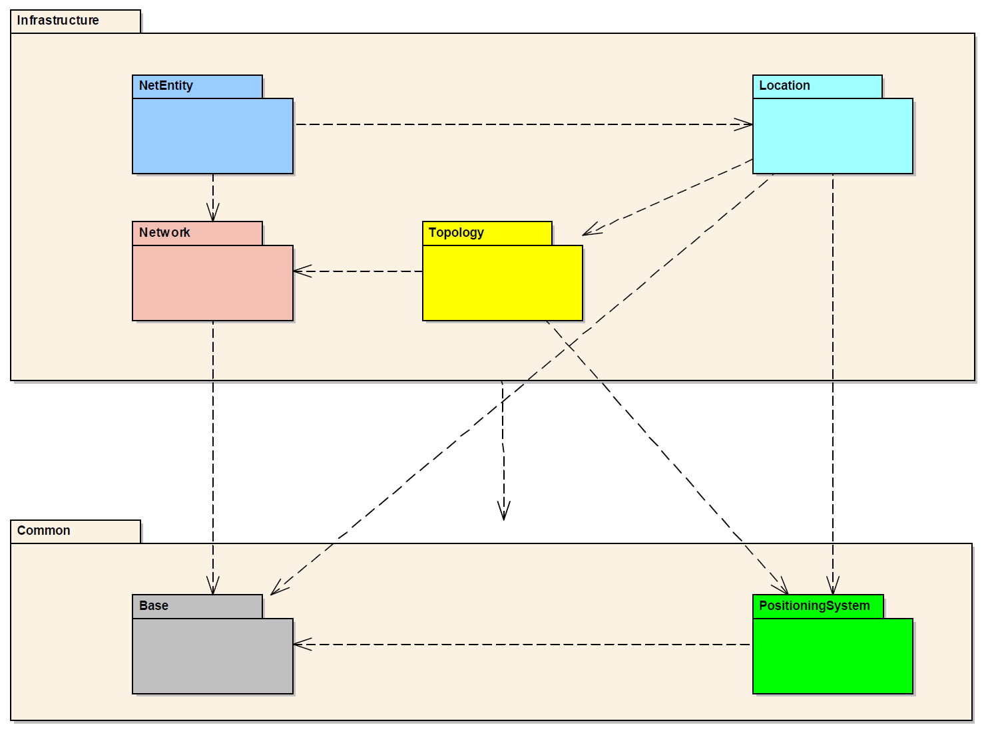
Conceptual clarity ensures extensibility and maintainability
Flexible link: object - position
Abstract classes for material or immaterial objects
Several scales, but
single data repository
Central RTM concept
Linear or geographic positioning
(OGC-compatible)
Data Persistence
Time
Units
Measures
RTM 1.1 package structure
Notes:
RTM may appear complex at first. The reason is, concepts have been disentangled and grouped into separate packages.
This figure illustrates the current packages with their main purpose.
The role of the « topology » and « network » packages have been explained before. Each further package fulfils one, and only one, essential purposes:
This ensures that the model is semantically clean, can be maintained in the long run, and can be coupled “flexibly” with other models, such as those currently developed by EULYNX for signalling. By putting abstract classes or interfaces at the disposal of others, links can be established without the need for mutual micro-management. Models using RTM do not become RTM “slaves”. Conversely, it is possible to enrich RTM with a low risk of disturbing other developments. [these are well-known information system design principles – see for instance “SOLID” and “low cohesion, high coupling” notions].
Noteworthy are:
the “Location” package, allowing the flexible coupling of objects with one or more coordinate system: GPS, geographic, linear (such as kilometric points)…
The “Net Entity” package, that provides abstract classes for representing network objects:
Material ones such as tracks or signal masts or OCL;
Immaterial ones, such as speed profiles linked with track geometry or with signalling, routes, movement authorities, etc.
However the “Net Entity” package makes no assumption about the signalling system, for instance, neither does it make any assumption about how the signalling system will be represented!

Slide 8
The importance of being semantic
Models and ontologies

Slide 9
UML Class diagrams: hype, and the deeper relevance
Four types of class diagram abuse:
Class diagrams as over-sophisticated, under-used object models …
  Often w/o methods (platform-specific!)
  Often without constraints (OCL is little known!)
  Often lacking clear semantics (documentation is costly and boring)
  Banning multiple inheritance for good, but also bad, reasons
… or as first step in model-driven engineering …
… or as an iterative step (conceptual model ➔ implementable model)
… or rather, an intermediate step?

Slide 10
From knowledge to applications
Evolutionary path?
Offsetting overhead with quality and speed benefits, using model transformation and
code generation

Slide 11
Ontologies: are they needed?
Yes.
Example : EULYNX Data Preparation
  > 430 classes
  > 4000 properties, of which 1100 are distinct
Example : IFC-Rail
  Bilingual (English, Chinese) from ground up

Slide 12
Ontologies: flavors and usages
Representational ontology: « dictionary ontology »
or
Domain ontology, as formal & explicit business requirements
Ontologies as a step in the development
or
Ontologies as a component in architecture

Slide 13
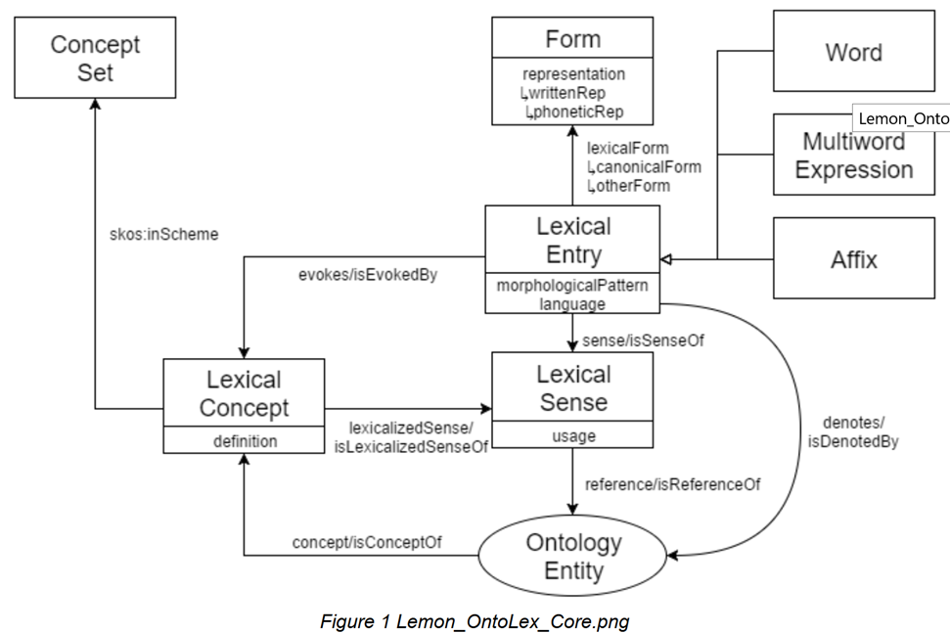
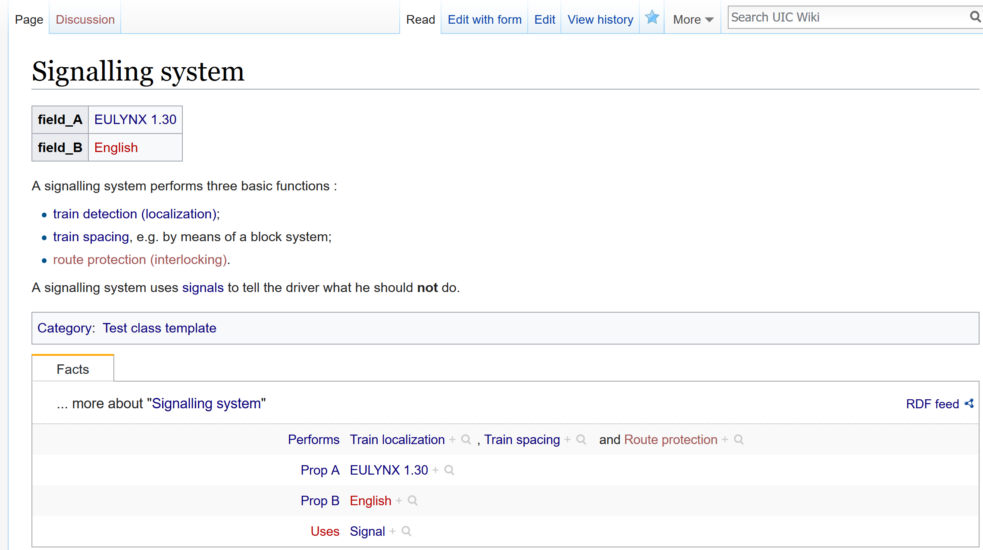
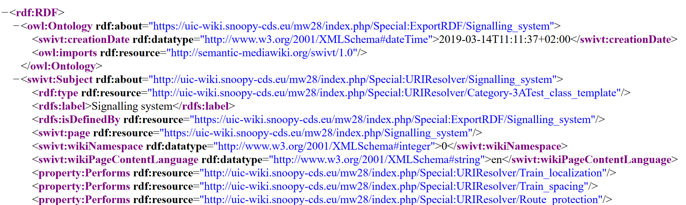
Human-manageable, machine-discoverable
A slice of LEMON…
… and a peek into the draft semantic Wiki …
LEMON: multilingual dictionary ontology – W3C
MediaWiki + extension: Semantic Mediawiki, RDFIO…

Slide 14
Comprehensive system representation
Putting flesh on the bones

Slide 15
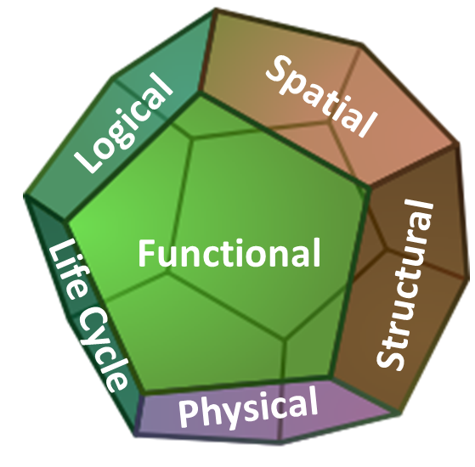
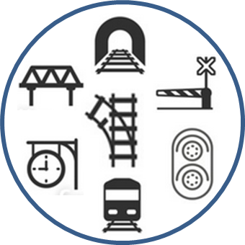
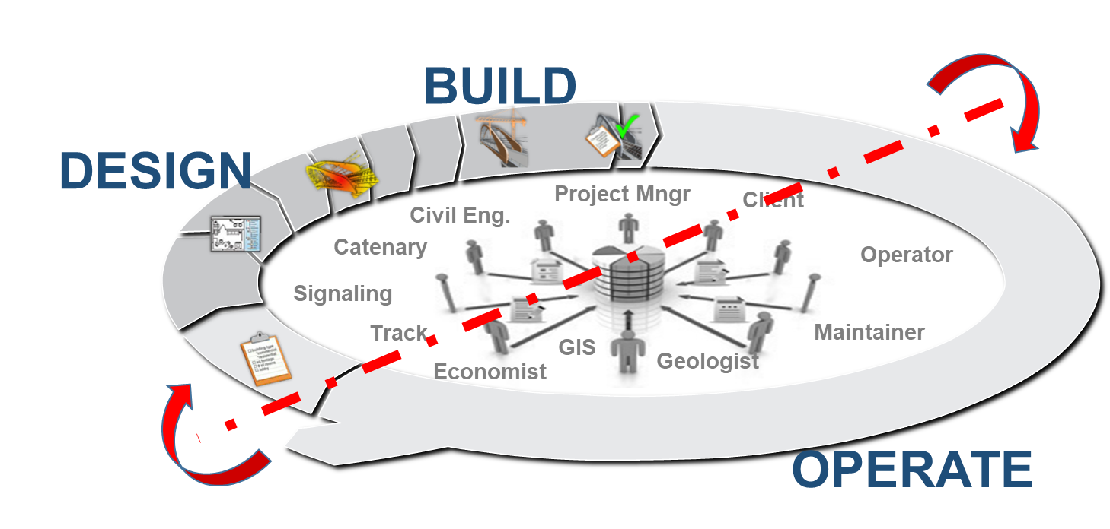
Railway System challenge
Information Modeling to ensure Digital Continuity
for the whole system, over its whole lifecycle

Slide 16








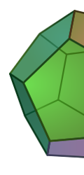
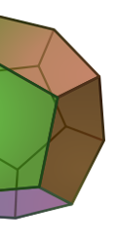
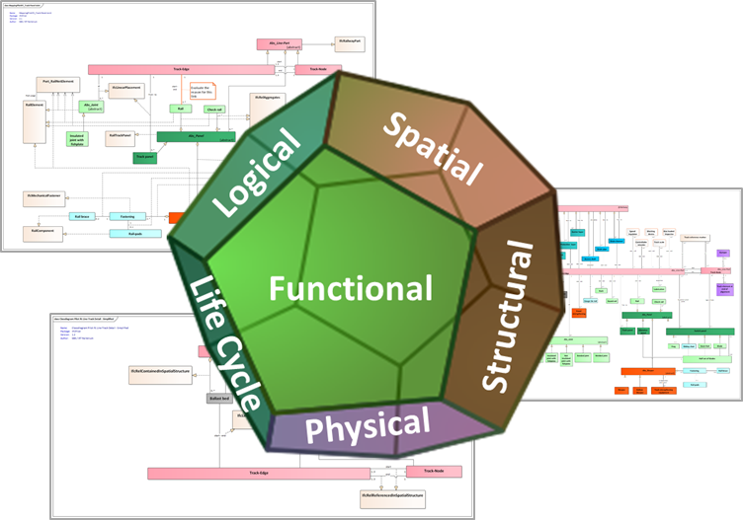
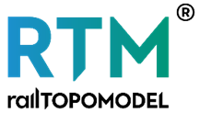


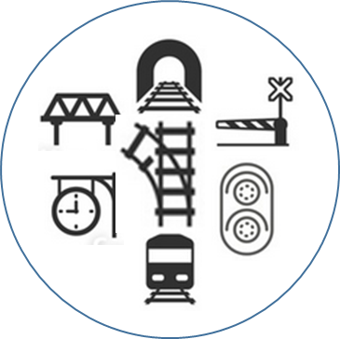
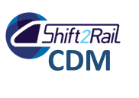

The Railway System is complex …
Managing its life cycle and related information is complex !
Rail System behaves
as a whole
… with its multiple sub-systems
and facets,
… leading to
several Standards
… multiple
Processes & IT Solutions
Design
Build
Maintain
Finance
Survey
Operate
ALL processes, actors, solutions contribute to manage the same System
… and should act as One : Digital Continuity

Slide 17
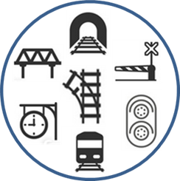
Railway System complexity : sub-systems and facets
Railway System is structured in subsystems
… each of its concepts has multiple Facets
Sub Systems
Track
Signaling
Energy
Telecom
Concept.
Object
Each Facet is represented by a specific Object, with its own UID and related properties.
System model and Digital Twin should cover the whole business scope
Dictionary
ID-D
Structural
Object
Catalogues
ID-C
System Facets
Functional
Object
Design
ID-F
System Model
should cover all required facets, to be instantiated in
IT environments
Physical
Object
Field
ID-P
Each concept, at every level of FBS/PBS/Geospatial Breakdown Structure… is modelled with its multiple relevant facets

Slide 18
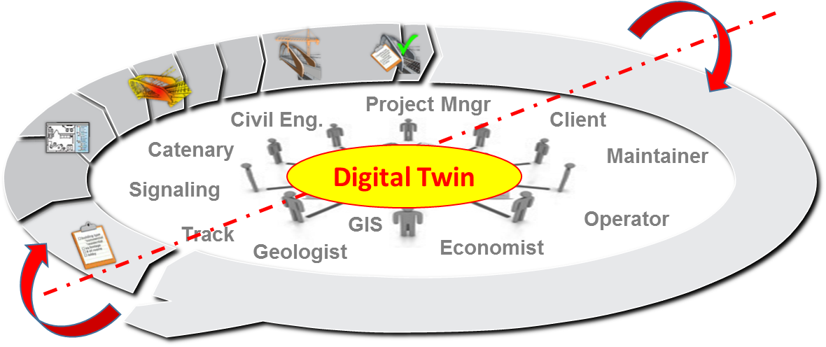
System Modelling : Concept life cycle & stages
A business infrastructure concept has multiple incarnations during its life and operation
Catalogue*
* Enterprise Catalogue with the ‘Internal standard products’ ,
and Manufacturer Catalogues
Referenced
Item
Dictionary
(Structural)
Digital Twin
Business
Concepts
Project Model
Maintain
+
State(s)
(Physical)
Requirement
Design
Build
(Business)
(Functional)
(Physical)
Operate
+
State(s)
(Functional)

Slide 19


System Modelling : Concept and related objects
At each stage, a concept requires the instantiation of a specific object,
with its own Unique IDentifier, and its specific, relevant properties values
Catalogue
Dictionary
Project Model
Digital Twin
Requirem.
Design
Build
Maintain
Operate
State(s)
Referenced item
Concept
Business
Functional
Physical
Physical
Functional
Func/Phy.
Object
Object
Object
Object
Object
Object
Object
Object
ID-C
ID-D
ID-B
ID-F
ID-P
ID-P
ID-F
ID-XX
X
Identificat.
X
X
X
X
X
Related to what is traced (survey of infra, simulation of functional, tracking of operation,…)
Manufactured
Functional
As Required
As Designed
X
Manufactured
Technical
As Built
As Maintained
Location
As Designed
As Built
As Maintained
X
Objects Properties
Manufactured
Geometry
As Designed
As Built
As Maintained
Life cycle
X
X
X
Condition
As Required
As Designed
Operation
As Required
X
Manufactured
Mainten.
As Designed
As Maintained

Slide 20
System Modelling : Object life cycle & Digital continuity (1/2)
Each stage / object is precisely related to one/many others
all those relations must be modelled
2
1
3
4
Catalogue
Dictionary
Project Model
Digital Twin
Referenced
Item*
Business
Concept
Requirement
Design
Build
Maintain
Operate
State(s)
Business
Functional
Physical
Physical
Functional
Func/Phy.
2-a
3-a
3-b
3-d
4-a
4-d
3-c
4-b
4-c
2-a | A Catalogue is structured on the basis of dictionary objects/properties
3-a | Requirements are defined on dictionary objects/properties
3-b | Functional objects (CAD) are designed to fit Requirements
3-c | Designed objects are drag/drop from catalogues (when relevant)
3-d | Infra physical objects are implemented to fit design (when relevant, product from stock with item nbr,…)
4-a | Maintained objects are initialized from built physical objects (handover)
4-b | Operated objects are initiated from functional objects
4-c | Infra life cycle requires logging of “photos” (surveys, IoT & sensors,…)
4-d | Tracking of infra activity (switches, signals,…) requires logging of states
* Enterprise Catalogue with ‘Internal standard products’ or Manufacturer Catalogues

Slide 21
Some advice for system modelling
The main objectives of system modeling is to handle, consistently, all dimensions required to run a system virtually as it lives and operates in real life (“Digital Twin”)
One main complexity in modelling a complex system is to initiate it… and enrich it progressively,
not knowing what will be the next evolutions (objects, relations, use cases).
The major risk being to have to refactor the existing model each time you face unforeseen situation. Refactoring a model is a major cost driver, and a blocker in term of reactivity to business.
The answer to this complexity and risk is to design a model “independently of use cases”,
Model the functional and physical objects as they are, and not as they are used (at a certain time).
Then, in a second step, model “how they are used”.
The modeling pattern of choice is the “Mediator pattern”,
to handle multiple stages of a concept, in a sustainable and scalable way.
Mediator objects = <xx>

Slide 22



Continuity between two related objects is managed via a “linkage object”
Asset Manager (IMs,…)
Manufacturer
1
ID-C
Functional Asset
Signal Type AAA
Object description
Properties,
3D geometry,…
Signal
Manufacturer Catalogue (Structural)
Object Type
+ Positioning
+ Relations
ID-F
“Functional
to Physical” Relation
3
Item Ref XYZ
From dd-mm-yyyy
To dd-mm-yyyy
Life Cycle of every Functional &
Physical Assets
xx
Manufactured products
2
ID-P
Physical Asset
Supply
Process
Item Ref XYZ
Field
Installation
Inventory Management
Item Ref XYZ
Design takes the required functional signal from manufacturer’s catalogue
Field get the physical item from the manufacturer / storage, via supply / inventory process
History is traced via “functional to physical” linkage object

Slide 23
Combining models
From cooperation to federation – the S²R CDM initiative

Slide 24
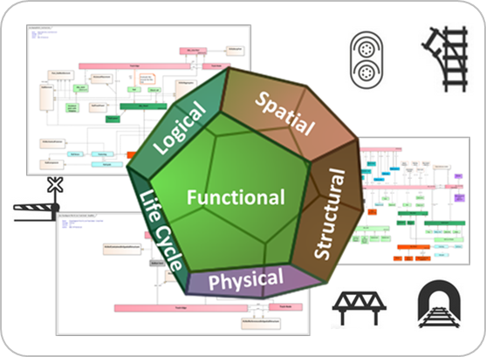
Agile, Global System Model ? the challenge
Railway System Model, with its multiple sub-systems and facets, will end to model thousands of objects.
Enterprise performance requires the consistency of the whole, all sub-systems, all facets.
Enterprise efficiency requires agility for each domain; to be refined and adapted to evolution.
A monolithic model is not viable; we require decoupling between domain models, for autonomy but not independency.
The challenge is how to let each domain to model its own perimeter (subsystem/facets) with sufficient autonomy for agility,
while ensuring further consistency of the whole System model

Slide 25
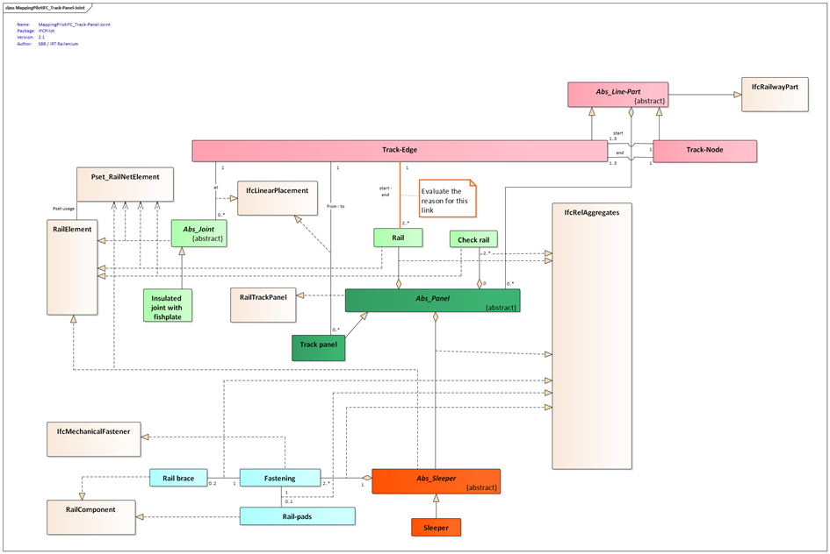


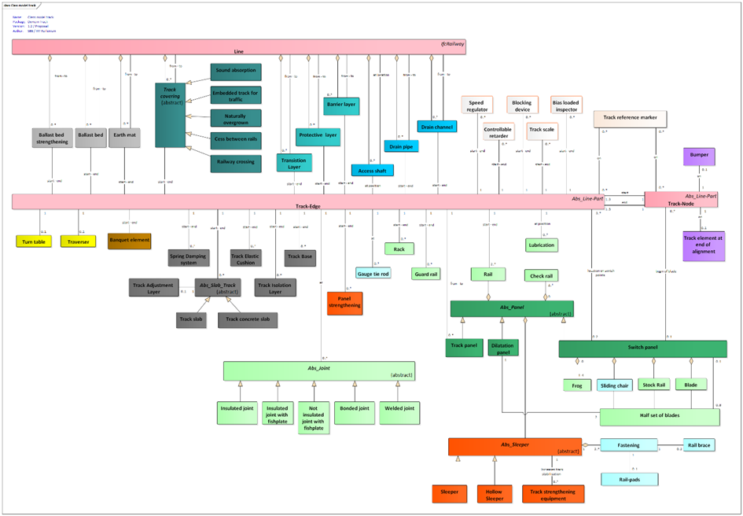
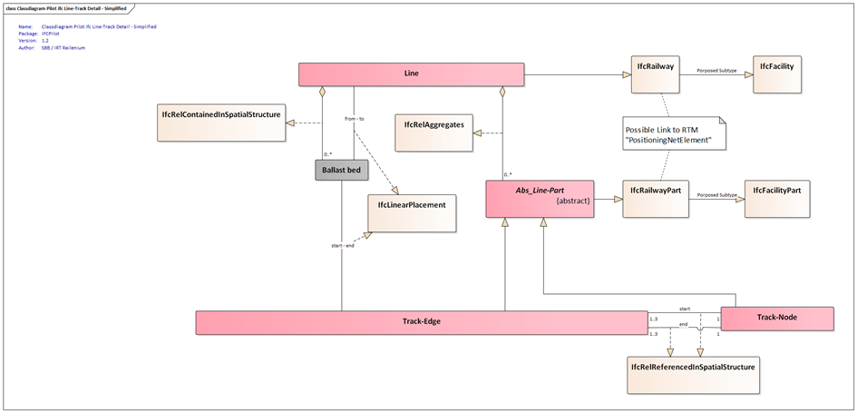
Agile, Global System Model ? the current situation
Sub Systems
Signaling
Telecom
Energy
Track
Functional
Each standard handles parts of the system models, both in terms of sub-systems and/or facets
Design
Logical
Design-Operate
System Facets
Geometry
Design-Build
Physical
Operate
SysML, UML,… Models

Slide 26
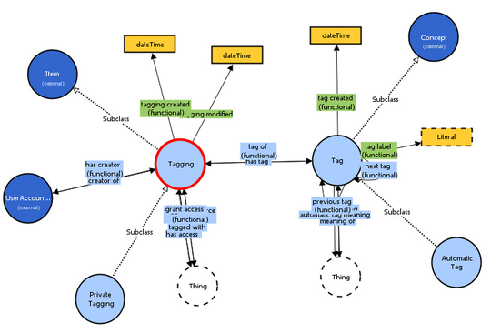
Agile, Global System Model ?
Means
How to preserve autonomy and consistency:
Uniquely identify concepts and their relations (properties) across models (UML… or others!)
➔ Develop & use domain ontologies
The global consistency of multiple ontologies managed by several autonomous teams requires three constraints to be applied by all teams:
A shared dictionary of “functional/physical” objects: OntoRail
A shared thesaurus of relations→ to be initiated, then maintained in Ontorail
An ontology language (OWL) and upper / general ontologies, if useful

Slide 27
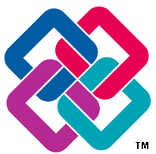

Common Data Model project
Common Data Model: a vision, and a business project by the Shift²Rail joint undertaking, to benefit from standard models by combining multiple parts of different models for several leading projects.
The challenge of CDM project is to make this combination feasible for end users (efficient, and sufficiently convenient, with regards to expected benefits, compared to going for a specific model).
Example of a project requiring objects and facets managed by multiple standards
Object A Track
Object E Environ^{t}
Object B Signal
Object G Traffic
Object D Energy
Object F
Population
Object C Rolling
Current candidates: RTM, Ontorail, EULYNX, railML, IFC, OGC

Slide 28
Positioning of CDM project: Combining models
Once objects, facets and relations required by end users are available in particular models,
the challenge is to combine consistently the “parts” yielded by those models:
e.g. combine geometry from IFC with functional aspect from RTM and logical aspect from Eulynx ?
Conditions for combination of models are
Unambiguous semantics → ensure all leading projects use and feed OntoRail
Unicity of objects involved in related models
Capability to combine relations from multiple models
Considering Classes A and B shared by RTM, Eulynx and IFC models
Functional relations between A and B are modeled in RTM
Spatial and geometry relations are modeled in IFC
Logical relations and behavior are modelled in Eulynx
Object A
Object B
Currently all standardization projects are modelling using UML or SysML, were relations are modeled using a graphical representation. Those graphics can be translated in machine readable language called XMI files (xml), but translation is not standard and XMI files are not always compatible. Moreover the extraction from multiple models, of the only relations required for a usage, will be a fastidious work.
A solution for CDM to manage those relations independently from each other, while providing capabilities for extracting, and combining, “what I need for my specific usage” could be to translate all standard models as ontologies in RDF format, handle as a global graph model, and managed in a dedicated repository (triplestore)

Slide 29
Conditions for a successful federation
Keep projects aligned on vision (consistency, complementarity)
Align the conditions and toolsets used by each project to support the vision (e.g. responsibilities, Ontorail feed/usage, procedures for ontology extraction or model transformation… ) → modelling handbook
Ensure and control implementation of decisions;
organize arbitration when necessary
Offer ‘one stop shops’ to developers and other users, including support and means for feedback (model enrichment to follow pace of technology)

Slide 30
Conclusion
Develop standards, develop on standards, and forget about « the standard that will replace all standards »
Open collaboration is the key to success
Create an academic network for collaborative railway digitalization:
  knowledge management,
  modelling, model transformation,
  open source software,
  Usage of the above.

Slide 31
Further information
Legacy websites :
  http://www.railtopomodel.org/en/
  http://wiki.railtopomodel.org/
New website (under construction) :
http://rtm.uic.org/
Download RTM 1.1 : https://uic.org/railtopomodel
Future : www.Ontorail.org
Contact: we recommend the functional mailbox rtm@uic.org

